Slide 1
New Zealand Certificate in IT Essentials
Course No: 4601 | Information Technology Foundations | Level: 4 Credits: 15
Student Name: | Student ID:
Assessment Type: Practical Assignment | Weighting: 60%
Due Date: | Total Marks:
Student declaration I confirm that: This is an original assessment and is entirely my own work. The work I am submitting for this assessment is free of plagiarism. I have read and understood the Academic Integrity Policy here. I have also read and understood the Student Disciplinary Statue here. Where I have used ideas, tables, diagrams etc of other writers, I have acknowledged the source in every case.
Student Signature: ML | Date:30/5/2025
Complete this!!
And include with your submission

Slide 2
Network manual
This is a template to support completion of 4601 – Assessment 2: Network Project. Refer to the assessment document for more information.

Slide 3
About this template
This is a template to support completion of 4601 – Assessment 2: Configure a Small Network.
Refer to the assessment document on Moodle for more information about what to do to complete the assessment.
Populate this template with your own images and text.
One of the sections should have narration for each slide. Insert > Audio > Record Audio
You may alter the layout of the template, or select a different template.
The total size of the powerpoint must not exceed 50MB.
Rename the template to include your name.
Delete the boxes in grey – they are there to prompt what should be included

Slide 4
Task 1
Configure the router

Slide 5
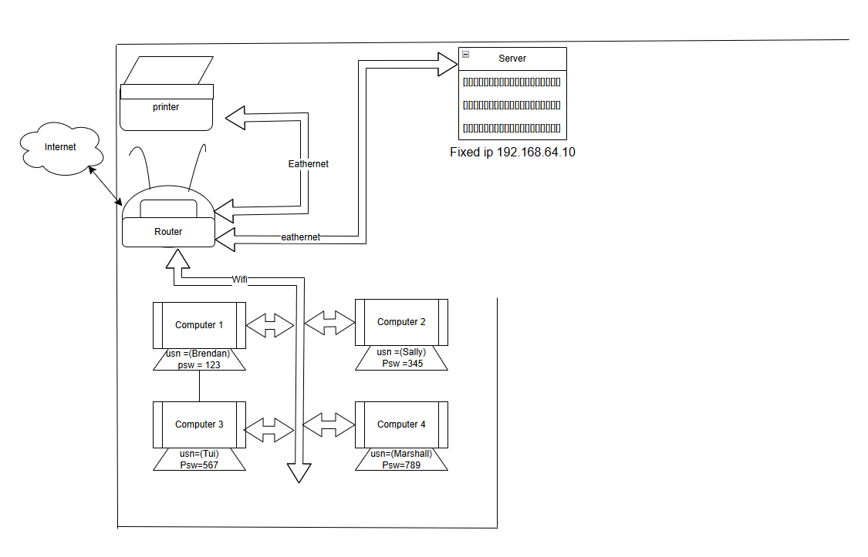
Task 1 Network diagram

Slide 6
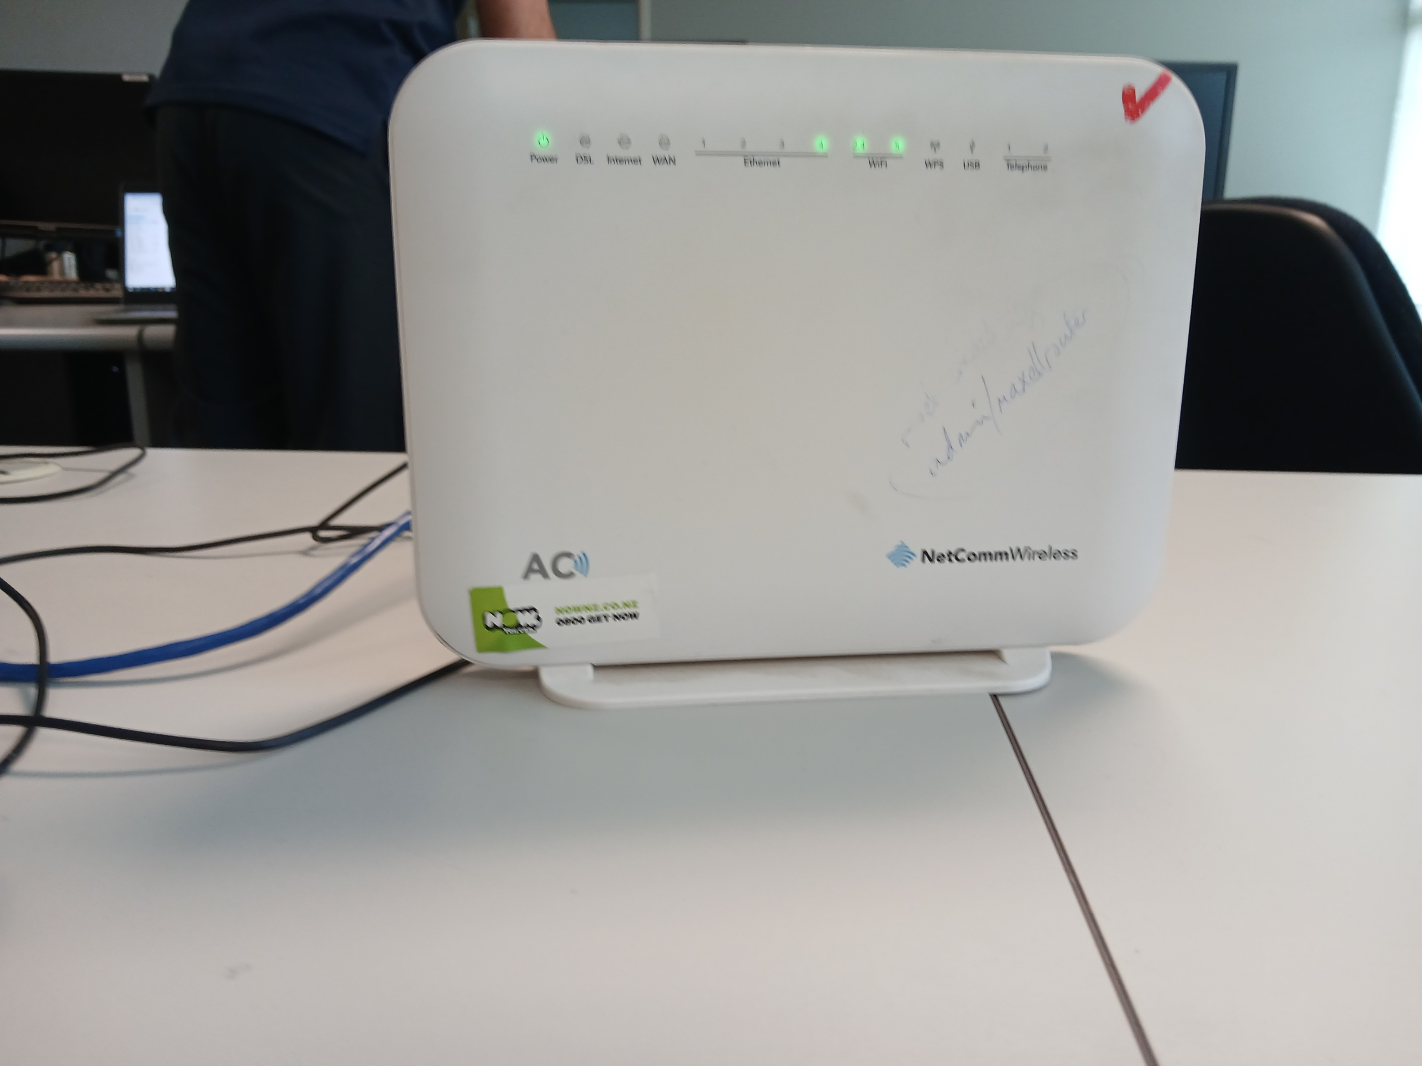
Task 1 Connect THE ROUTER
Step 1 –plug router into wall and turn it on
Step 2 –plug the router into the computer with an ethernet cable
Step 3 – reset the router
Step 4 – put in the Ip address on the designated device
192.168.20.1

Slide 7
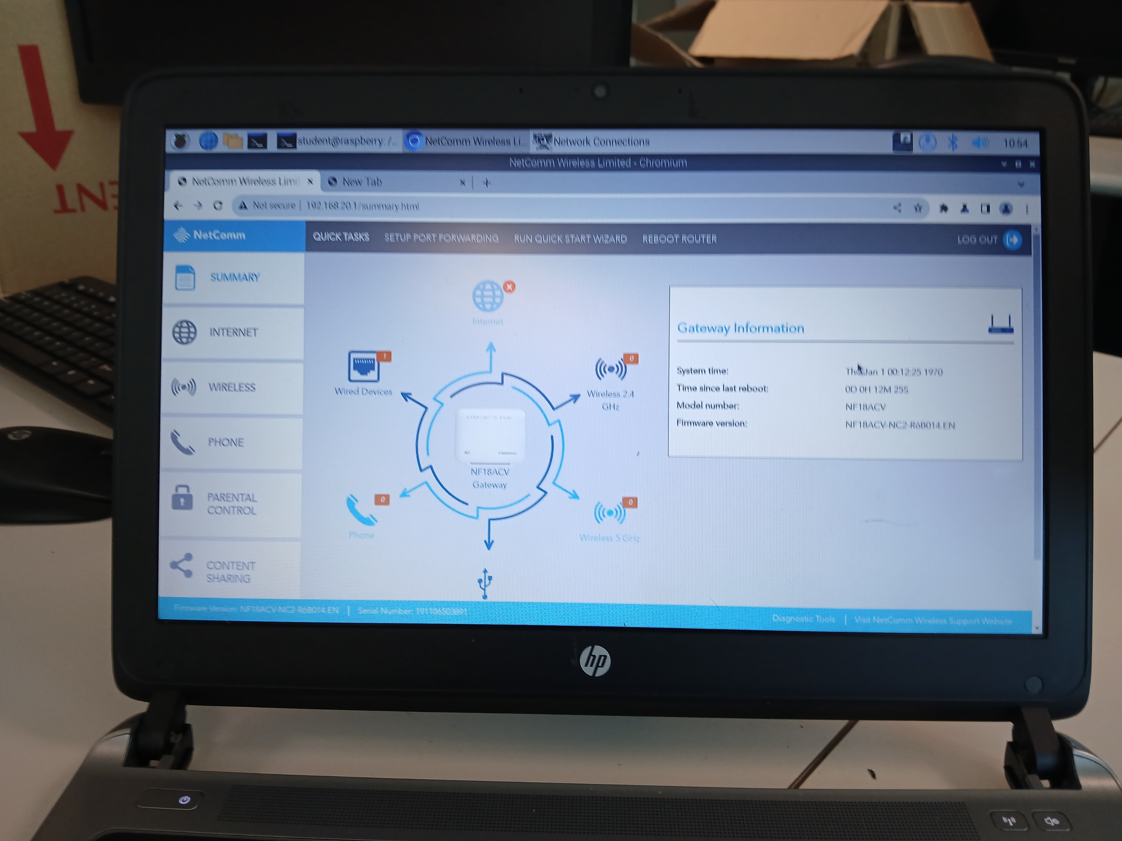
Task 1 Set up THE ROUTER
Step 1 – go into advanced settings
Step 2 – go into management
Step 3 – go into passwords
Step 4 –enter previous password and old username ((admin)) (maxellrouter))
Step 5 – enter new username ((admin)) put in new password ((wordpass))

Slide 8
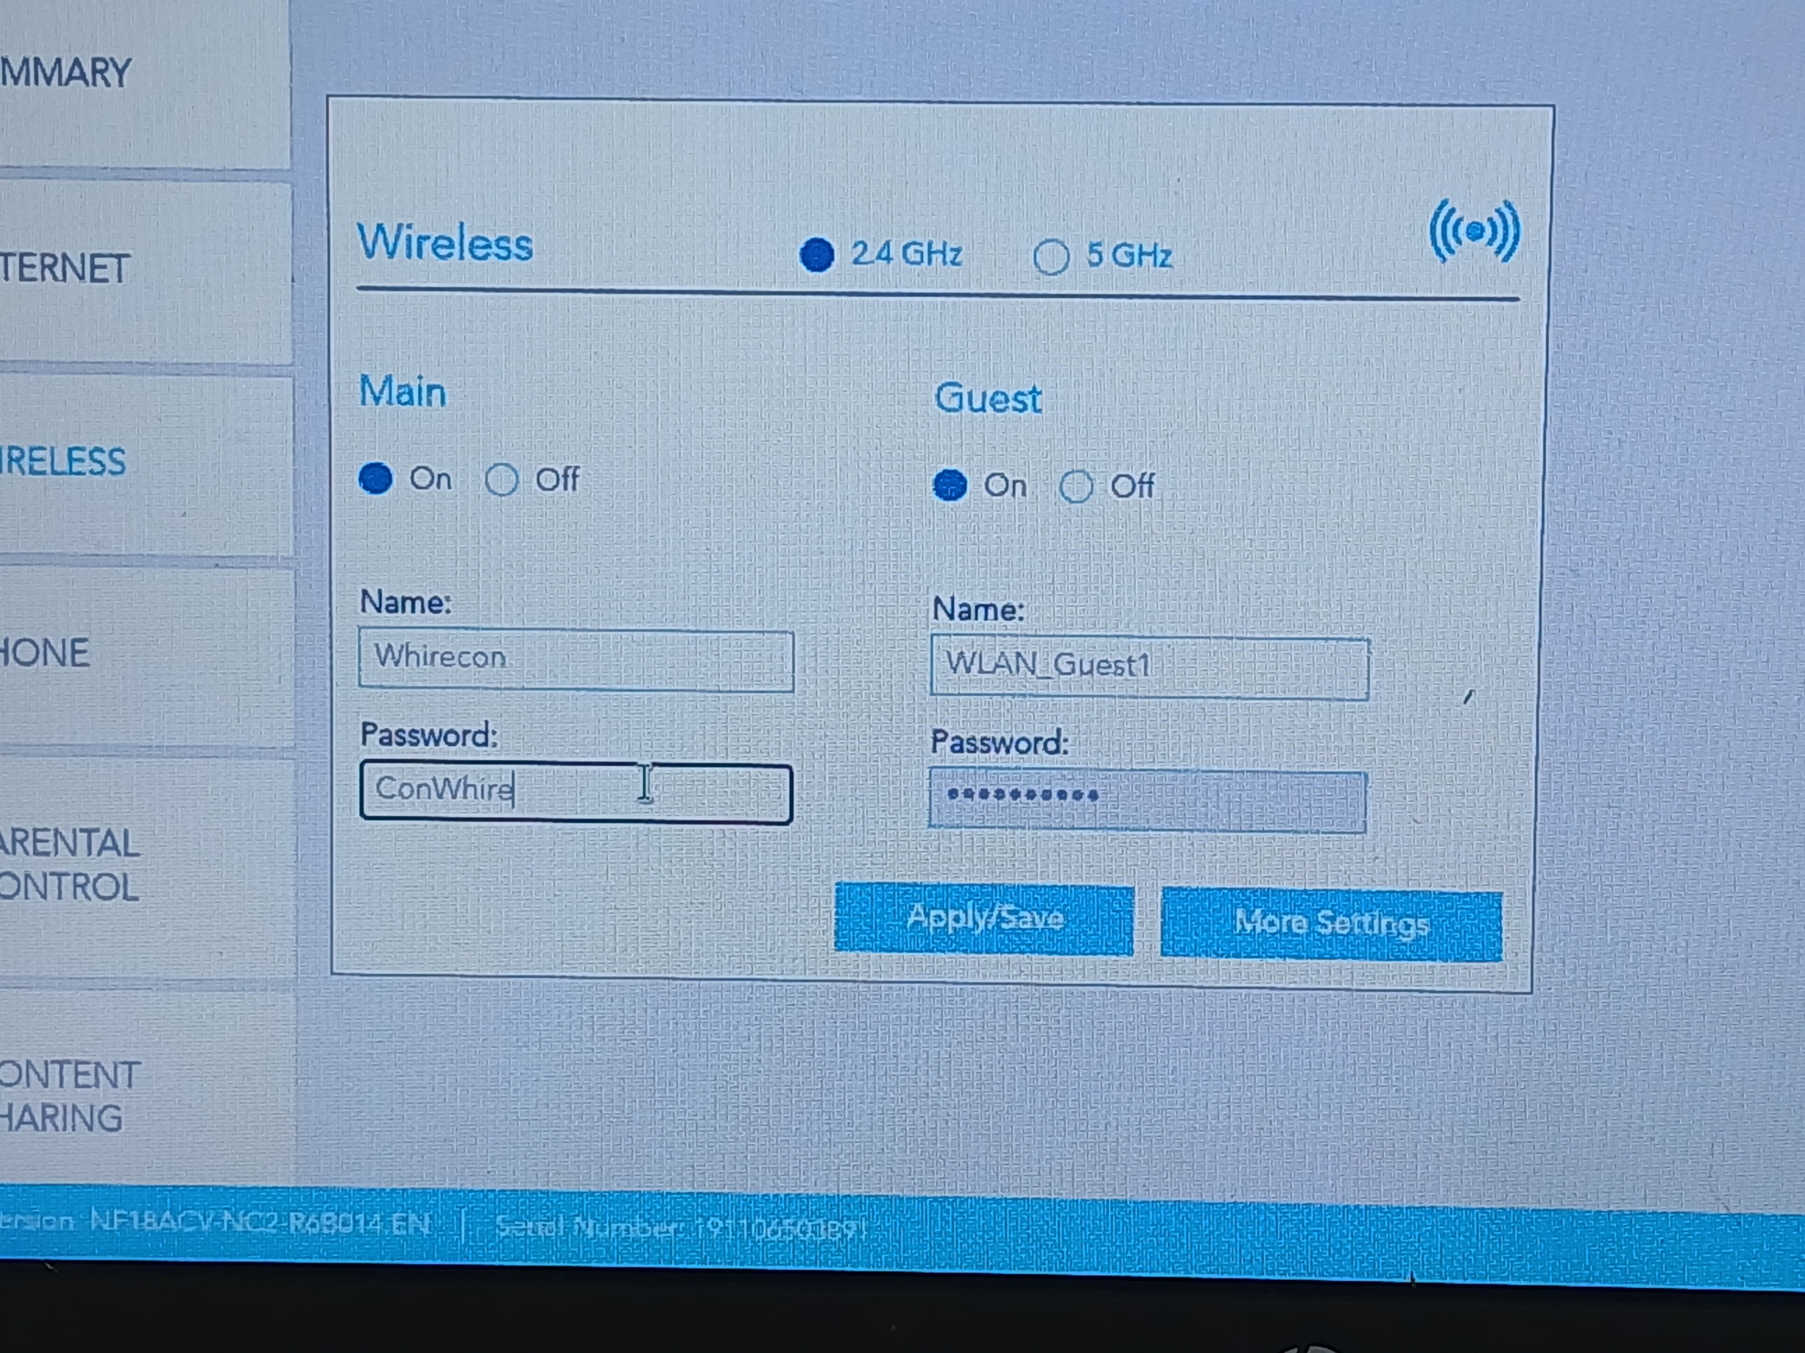
Task 1 Set up THE ROUTER
Step 1 –go into admin
Step 2 –put in username and password
Step 3 –navigate to the whierliss settings
Step 4 –change ssid name ((Whirecon))
Step 5 – change the password((ConWhire))

Slide 9
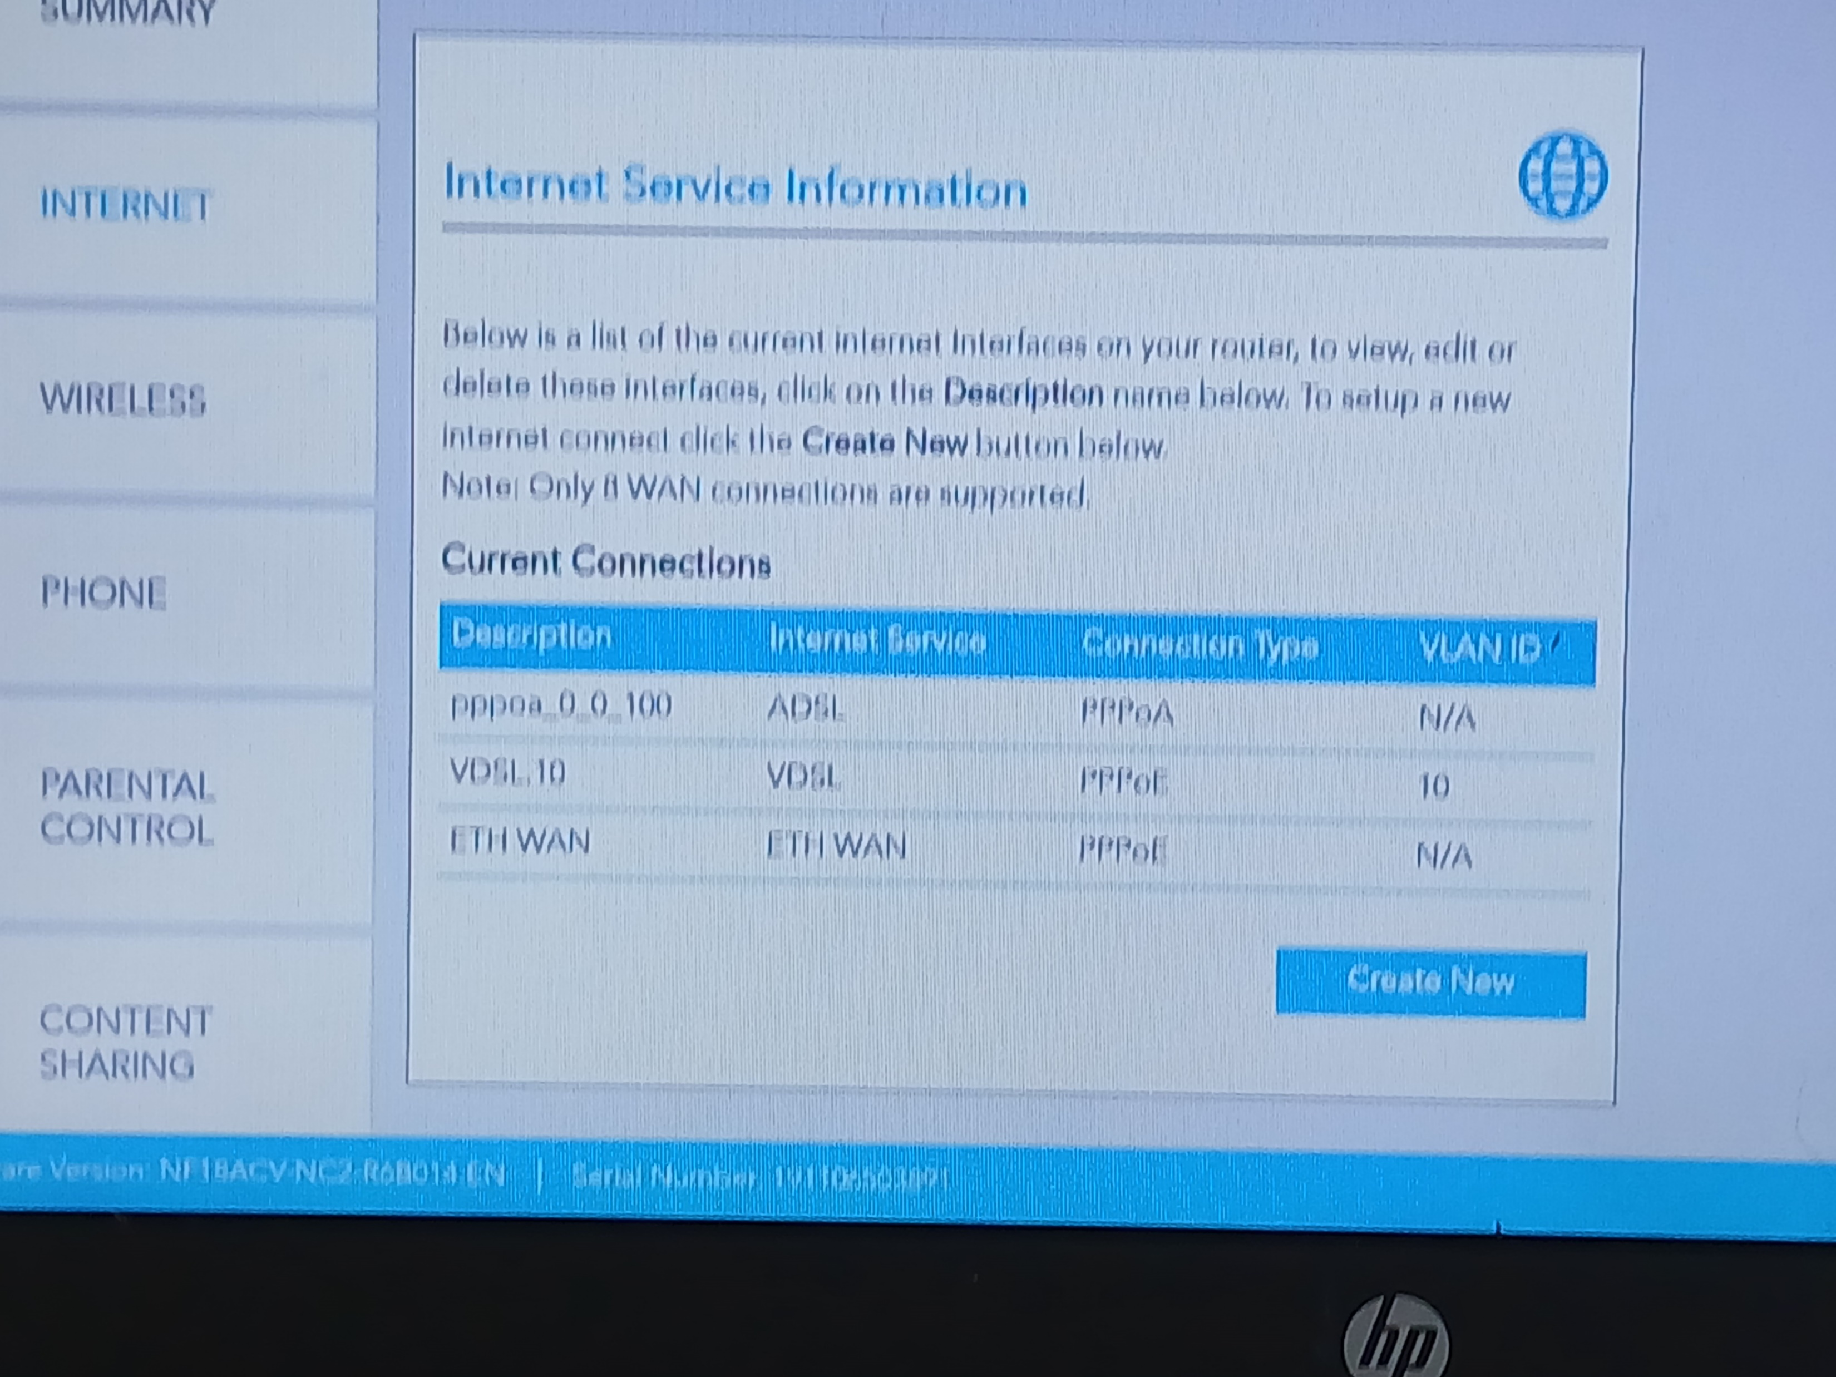
Task 1 Set up THE ROUTER
Check the connection to the internet
Step 1 – go into admin
Step 2 – go down into internet bar.
Step 3 –Look at the current Conections
Step 4 – or go to the serch bar and look up any websight to see if it loads.
Step 5 –

Slide 10
Task 1 FAQ
Question: what slot to I plug into the router to configure it ?
Answer: make Shure you use an Ethernet cable to plug into the router and plug the Ethernet cable into the WAN port on the router
Question: the router is turnd on and i pluged in the eathernet cable but i can't find the router on the wifi network why is that ??
Answer: as you are using an eathernet cable so it wont show up in the wifi(wireless) as it is coneced vire the eathernet cable(wired)

Slide 11
Task 2 enable a remote configuration of the rspbery pi server

Slide 12
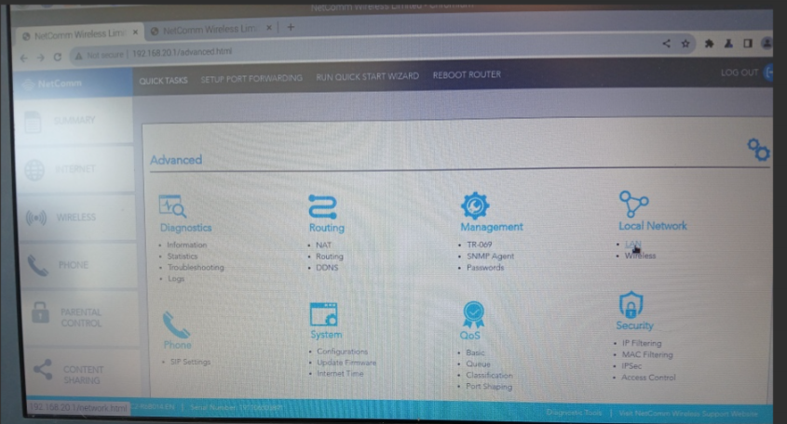
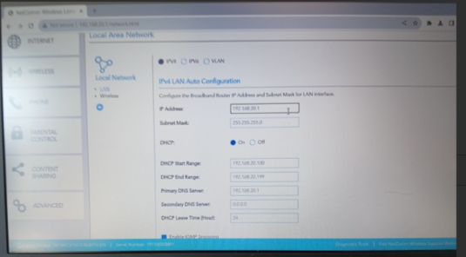
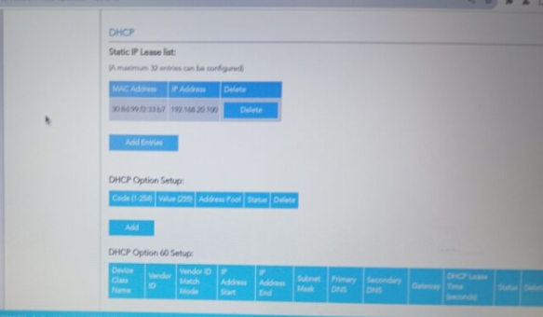
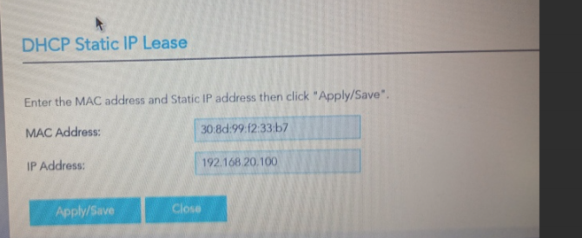
Task 2 assign a reserved ip address to the server on the network
Step 1 – log into the router
Step 2 –go into DHCP/ DHCP clients in the advanced tab and then lan so we could look at the static ip address (internet Local Network)
Step 3 –Copy your assigned IP and Mac address
Ip (192.168.20.1
MAC(F8CA591EA48D)
Step 4 –go to add enterys under DHCP(in lan)
Step 5 – enable the static ip

Slide 13
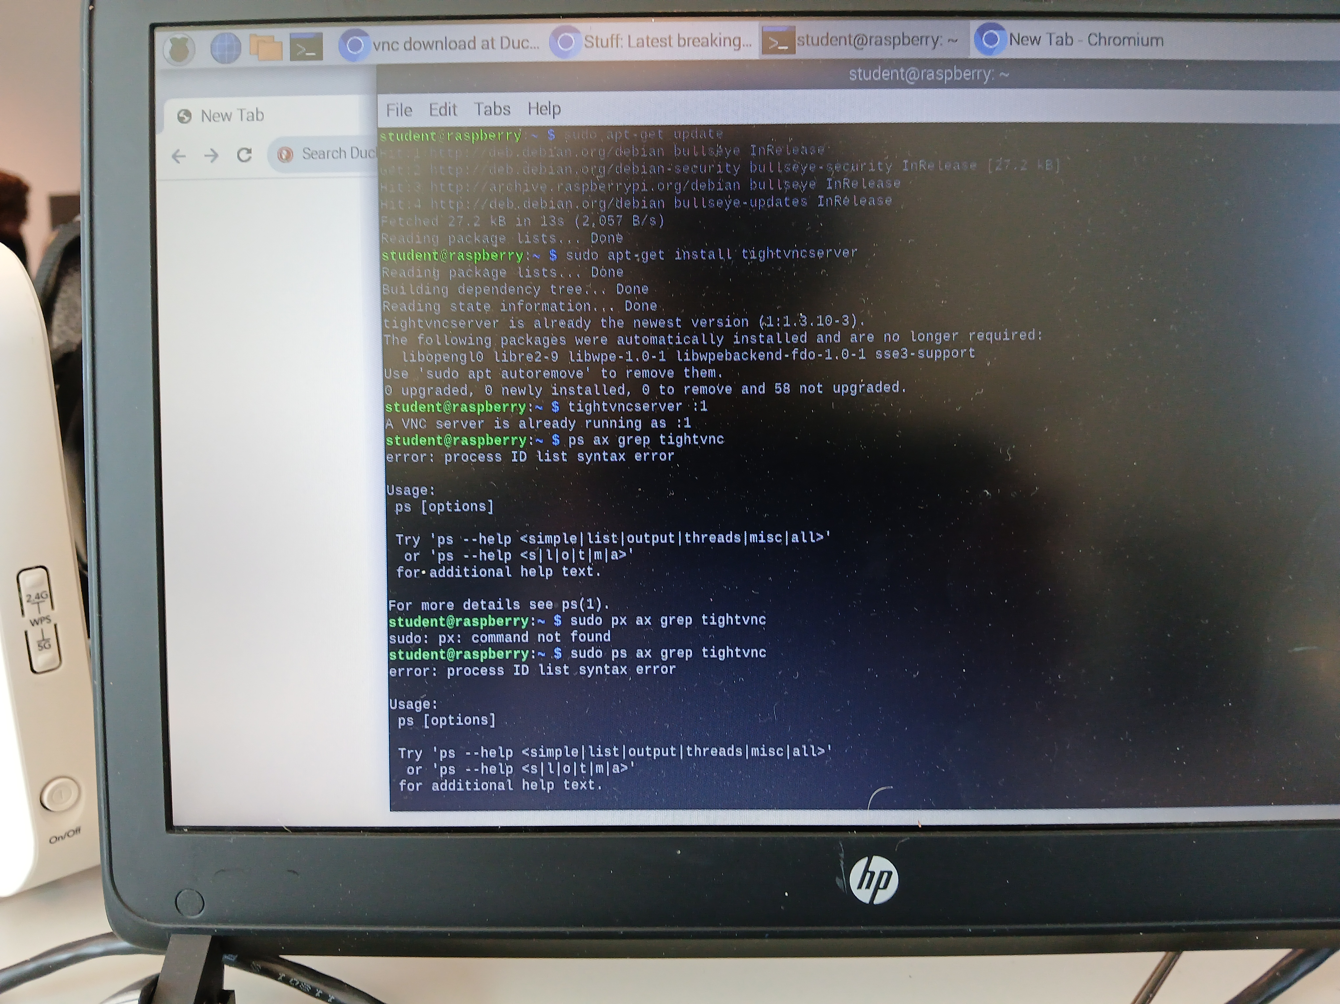
Task 1 set up the server so it can be connected remotely via vnc
Setting up tightvnc
Step 1 – Sudo apt-get update
Step 2 –Sudo apt-get install tightvncserver
Step 3 –tightvncserver :1 and password (password)
Step 4 –Sudo ps ax grep tightvnc
Step 5 –Sudo.netstat -lpn
–open up the new server you have created and put in your user and password

Slide 14
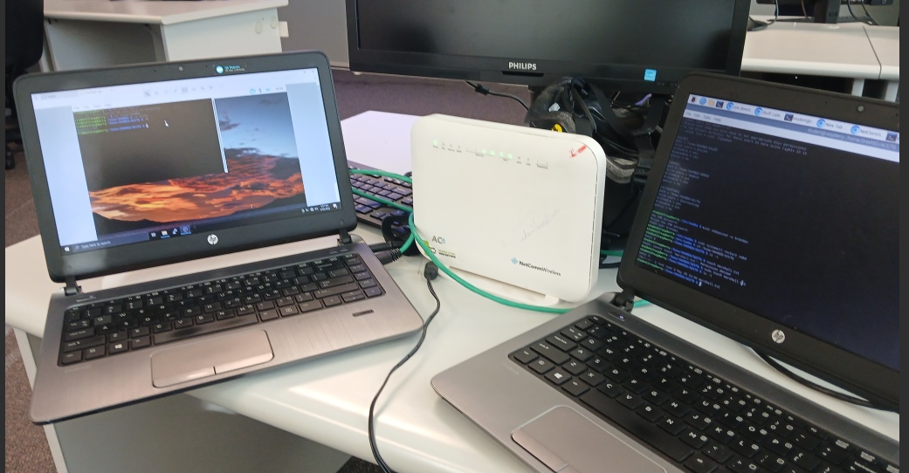
Task 2 Set up Sallys pc to conect to the server remotely
Step 1 –open up VNC viewer
Step 2 – go into propertys and settings
Step 3 – in the Remote Hoste box type the Pi,s address and screen number.
Step 4 –click Conect. Enter the VNC password created when setting up the server.
Step 5 –
To conect to the server
1 sudo smbpasswd –a (username) = adduser
2 sudo smbpasswd –e (username) = enable user

Slide 15
Task 2 FAQ
Question: How can I securely enable VNC to access the Raspberry Pi remotely?
Answer:
TightVNC = shows you the Pi’s desktop
Tailscale = makes a private path between your PC and Pi, like a secure cable
So, start with (vncserver :1)
(install and login to Tailscale on the pi and your computer
(get the pi's Tailscale ip using(tailscale ip –4))
And finally connect to it
Question: How can I access my Raspberry Pi from outside my local network (over the internet)?
Answer:
You will be able to acces outside of the local network while using tailscale.

Slide 16
Task 3
Set up the rspbery pi server for file shearing from the windows laptops

Slide 17
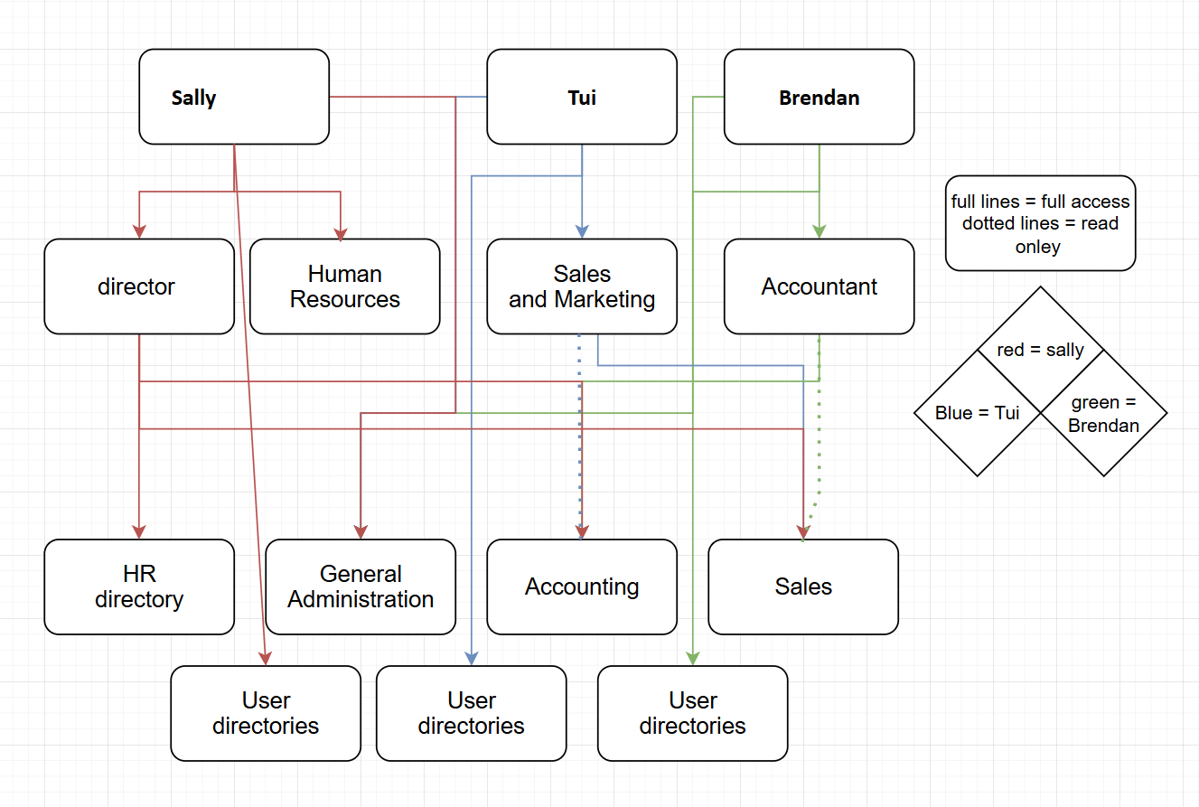
Task 3 file structure

Slide 18
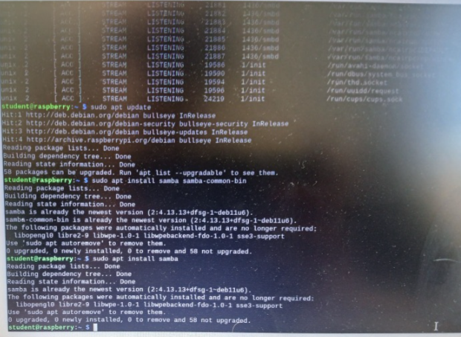
Task 3 samba setup

Slide 19
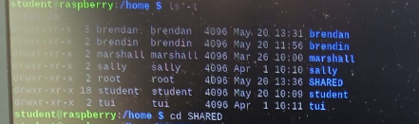
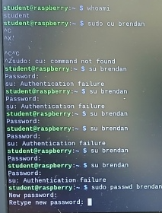
Task 3 samba setup
Create an account for each worker along with a samba password

Slide 20
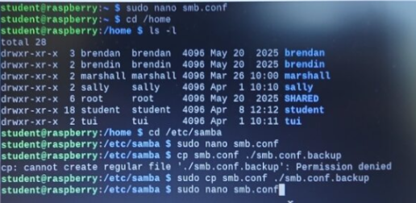
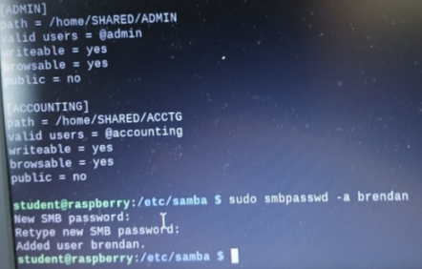
Task 3 create file structure
Step 1 –go into the terminle on the raspberry pie window
Step 2 – cd /etc/samba
Step 3 – (we create backup first)sudo cp smb.conf ./smb.conf.backup
Step 4 – sudo nano smb.conf
Step 5 –go to the bottom using arow keys and put in thease

Slide 21
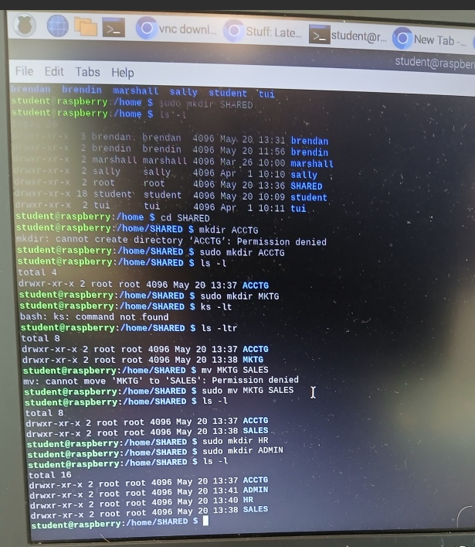
Task 3 create file structure
Step 1 – open up Terminal
Making group
Step 2 sudo mkdir SHARED(shared group)
Step 3 sudo mkdir ACCTG(accounting group)
Step 4 sudo mkdir SALES(SALES group)
Step 5 sudo mkdir HR(human resources group)
Step 6 sudo ls –l
# this will list out all the directory's

Slide 22
Connect users to the server

Slide 23
Task 3 FAQ
Question: What must be enabled on a computer to allow file sharing with others on the same network?
Answer: Network Discovery must be enabled so your computer can see and be seen by other devices on the same network.
Question: : How can you restrict access when sharing a file or folder?
Answer: You can set permissions to allow only specific users or groups to access the file or folder.

